Slide 1
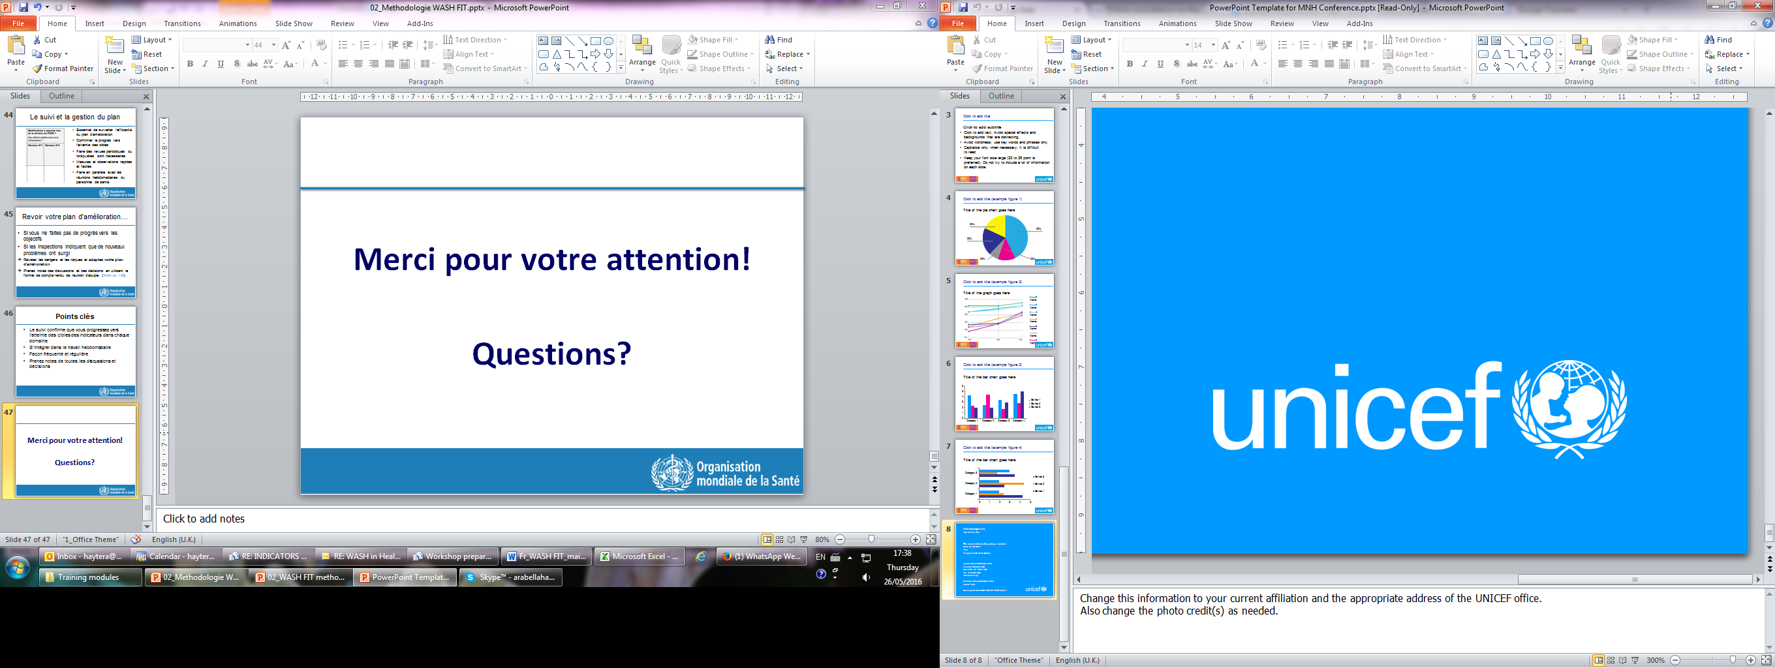
Module 4
SANITATION
WASH FIT

Slide 2
Overview
Minimum requirements for sanitation in health care facilities
Use and maintenance of sanitation facilities in health care facilities
How to share knowledge and skills to improve sanitation services in health care facilities

Slide 3
Importance of sanitation
Human faeces is the most common source microbial pathogens (germs). One gram of human faces has over 1,000,000,000 pathogens.
Germs are passed on from an infected person to a new host through contaminated food, fingers, fluids (i.e. water) fields (agriculture) and flies.
Safely managed sanitation systems (i.e. improved latrines / toilets connected to a sewer) are a primary barrier that breaks the transmission route by safely confining and treating faeces.
Safe water supply (fluids) and hand hygiene provide the secondary barriers to prevent faecal – oral contamination

Slide 4
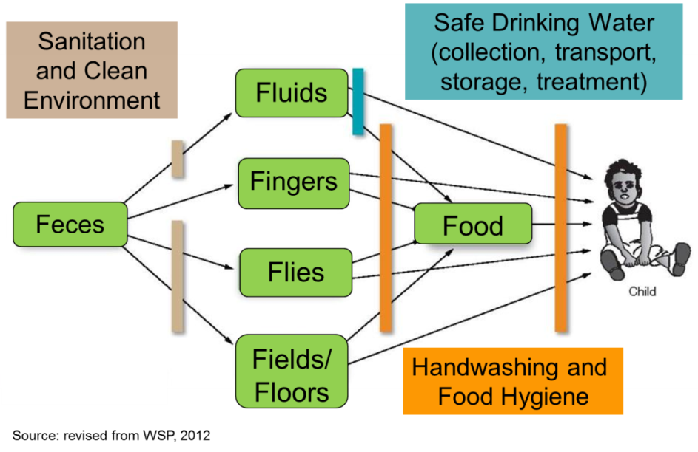
F Diagram

Slide 5
Barriers
Which are the primary barriers to spread of germs?
Which are the secondary barriers?

Slide 6
Sanitation Aspects
Toilets: Permitting safe defecation that protect public health and the environment.
Bathrooms/showers: Permitting safe body washing that protect public health and environment.
Safe management of feces and urine: Safe collection, storage, treatment, and disposal of human excreta.
Proper drainage and disposal of stormwater and washwater (grey water).

Slide 7
Global Sanitation Standards
Toilets and bathrooms should be on-site, usable and accessible to all staff, patients and visitors.
Toilets shall be clearly separated for staff and patients/visitors.
Toilets should be clearly separated for male and female users.
At least one facility should meet the needs of people with limited mobility and menstrual hygiene management needs.

Slide 8
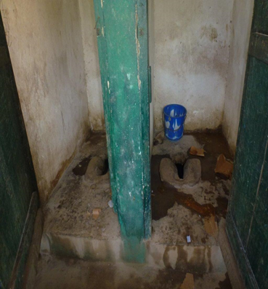
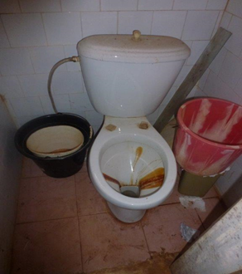
Global sanitation standards continued
Toilets should be usable
  A toilet/latrine should have a door which is unlocked when not in use (or for which a key is available) and can be locked from the inside during use, there should be no major holes in the structure, the hole or pit should not be blocked, water should be available for flush/pour flush toilets, and there should be no cracks, or leaks in the toilet structure. It should be within the grounds of the facility and it should be clean as noted by absence of waste, visible dirt and excreta and insects).
Toilets should have a functioning hand hygiene station within 5m.
Toilets should be cleaned every day, and have a record of cleaning clearly visible.
Toilets should be adequately lit for use at night

Slide 9
Global sanitation standards continued
Wastewater generated in healthcare facilities should be disposed of promptly and safely to avoid contamination.
Wastewater treatment facilities can be onsite or off-site depending on availability of such facilities.
Storm water should be drained through properly designed channels directing flow away from buildings and into a safe area in the environment.

Slide 10
Sanitation requirements
Toilets:
  Inpatients = 1 per 20 users
  Outpatients = 4 (male/ female staff & male/female patients)
Showers:
  Inpatients = 1 per 40 users
Wastewater:
  Will depend on types of latrines/toilets and number of users

Slide 11
Cleaning
Clean floors at least twice a day or as needed with wet mop, detergent and water;
Scrub sinks frequently with a cloth or brush and detergent and water solution;
Clean toilets frequently at least 2 times a day or as needed.
Ensure a good stock of supplies to permit effective cleaning
Make visible a signed cleaning record visible at all toilets

Slide 12
Managing and maintaining sanitation facilities
Train technical staff in operation and maintenance of facilities.
Ensure there is a process in place for rapidly addressing dirty or broken toilets.
Perform routine maintenance of sanitation facilities; if using pit latrines decommission when full.
Listen to all members of staff, including cleaners, technicians, managers, engineers.
Conduct supportive supervision and monitoring.
Remember that everyone has a role to play!

Slide 13
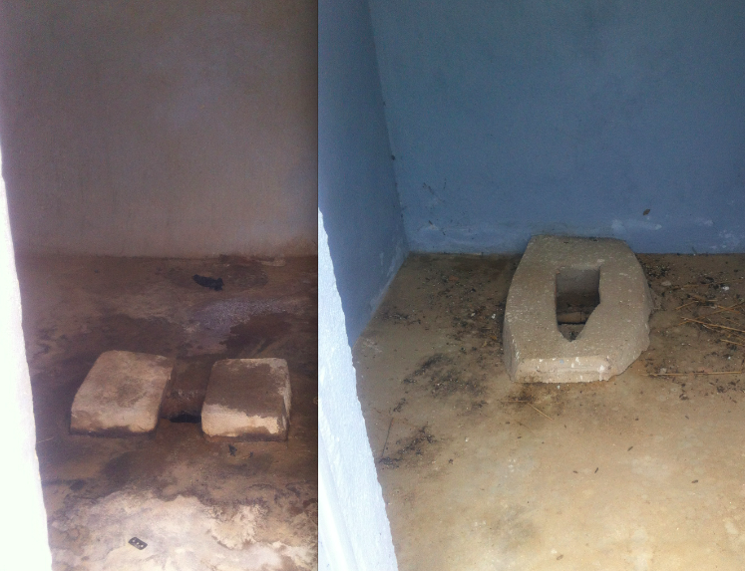
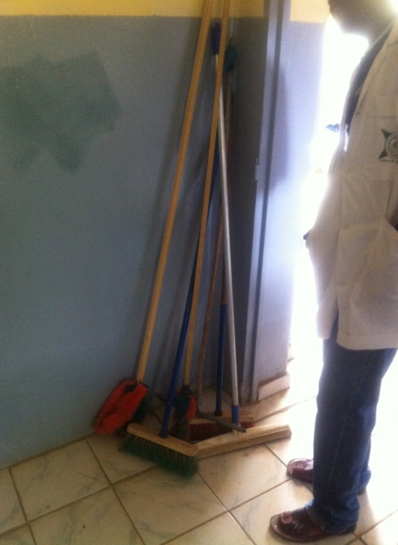
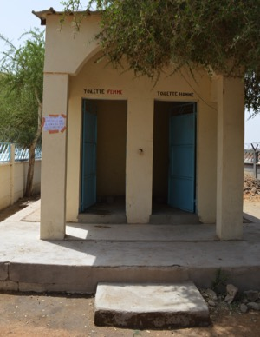
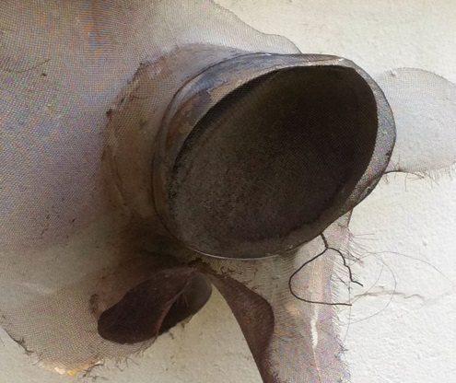
Simple improvements
Net on ventilation pipe to prevent insects entering
Concrete covering latrine
Gender separation painted on wall
Appropriate cleaning materials available

Slide 14
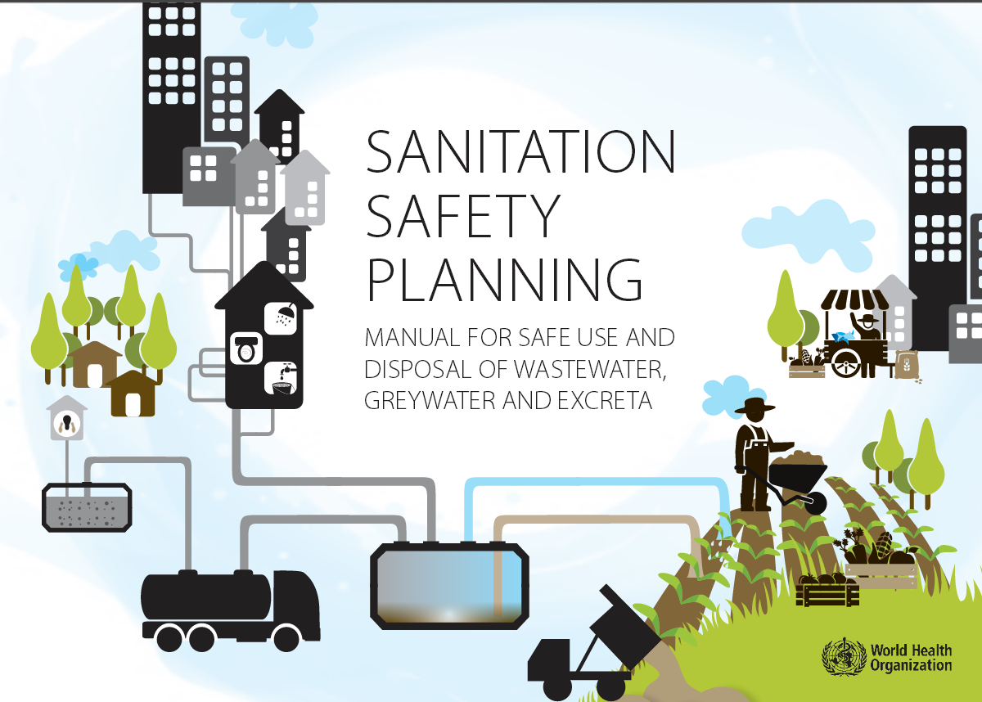
Safe wastewater management
Sanitation safety planning provides a framework to safely manage wastewater.
Sewage (flushing toilet water) should be disposed through municipal sewer system or with an appropriate septic tank/soak away pit system that is regularly maintained and monitored.
The wastewater soak-away pit should be approximately 30 metres away from water sources and more than 1.5m above the water table.
http://www.who.int/water_sanitation_health/publications/ssp-manual/en/

Slide 15
Storm water drainage
Facilities need storm water channels that are of sufficient size and functional.
Rain water should not flood nearby residents or communities to prevent the risk of spreading infectious agents.
Rain water should NOT be directed into septic tanks to avoid overspill.

Slide 16
WASH FIT sanitation indicators
ESSENTIAL
2.1 Number of available and usable toilets or improved latrines for patients.
2.2 Toilets or improved latrines clearly separated for staff and patients and visitors.
2.3 Toilets or improved latrines clearly separated for male and female.
2.4 At least one toilet or improved latrine provides the means to manage menstrual hygiene needs.
2.5 At least one toilet meets the needs of people with reduced mobility.
2.6 Functioning hand hygiene stations within 5 m of latrines.

Slide 17
WASH FIT sanitation indicators
2.7 Record of cleaning visible and signed by the cleaners each day.
2.8 Wastewater is safely managed through use of on-site treatment (i.e. septic tank followed by drainage pit) or sent to a functioning sewer system.
2.9 Greywater (i.e. rainwater or washwater) drainage system is in place that diverts water away from the facility (i.e. no standing water) and also protects nearby households.
2.10 Latrines are adequately lit, including at night.

Slide 18
Questions?

Slide 19
References
WHO (2015). Sanitation safety planning: manual for safe use and disposal of wastewater, greywater and excreta. http://www.who.int/water_sanitation_health/publications/ssp-manual/en/
WHO (2008). Essential environmental health standards in health care. http://www.who.int/water_sanitation_health/hygiene/settings/ehs_hc/en/
WHO (2011). Technical notes on drinking water, sanitation and hygiene in emergencies. Available at http://www.who.int/water_sanitation_health/publications/2011/tn9_how_much_water_en.pdf
WHO/UNICEF (2015). Water, sanitation and hygiene in healthcare facilities: Status in low-and middle-income countries and way forward. http://www.who.int/water_sanitation_health/publications/wash-health-care-facilities/en/
Swedish Red Cross (Ed.) (2008): Slide show of Swedish Red Cross water and sanitation module 4O ERU deployed in Philippines. Stockholm: Swedish Red Cross. URL: http://www.ifrc.org/Global/sw-watsan-eru-philippines0808.pdf [Accessed: 20.03.2015].
Peal, Andy; Evans, Barbara; Van der Voorden, Calolin (2010): Hygiene and Sanitation Software: An Overview of Approaches. Geneva: Water Supply & Sanitation Collaborative Council.

