Slide 1
MUM’S MAGIC HANDS
Global Storyboard

Slide 2
Strategic background
Oxfam and Unilever’s Chief Sustainability Office carried out extensive research on handwashing practice in emergency contexts. We found nurture to be one of the most powerful motivators driving handwashing with soap among mothers. Even during a crisis, mothers continue to nurture their children to ensure they go onward in life and succeed in bringing fruition to their eﬀorts and fulﬁllment to their lives. Handwashing ﬁts into this narrative of ‘nurture’, leading to ‘success’ ̶ not as a tool for good health, but rather as a part of a broader set of good manners like cutting nails, brushing and combing hair, honesty, hard work etc. that lead to living a good life.
Aﬃliation was also seen as a driver in emergency contexts. Mothers tend to unite together in emergencies, supporting each other and sharing resources. Other important elements for the story include the image of a dedicated spot for soap and water through very simple infrastructure, and the feeling of freshness from soap.
This central set of insights drive the creative idea shared in this presentation.

Slide 3
Central creative idea:
‘Mum’s magic hands’

Slide 4
Central creative idea:
‘Mum’s magic hands’
Mothers the world over have ‘magic hands’. Hands that put their children to sleep, that clean them, that help them learn to walk, that comfort their little ones by gently stroking when they are in pain. In fact, a mother’s hands do not differ from place to place or country to country, they all shape the lives of their children in very similar ways.
Hands are perfect metaphors that embody the lives of mothers everywhere and their heroic eﬀorts to nurture their children against all odds. Hands, on the other hand, are the central protagonists of handwashing with soap (HWWS). The rational arguments ̶ of killing the germs on the hands to prevent illness, cleanliness of hands, etc. ̶ are based on the way mothers use their hands in daily life, particularly in an emergency context.
The following story looks at the lives of 4 children: Meena from South Asia, Miriam from the Middle East, Mimi from Africa and Maria from Latin America. It shows how their mothers’ magic hands care for and nurture them during difficult times, and the universality of mothers everywhere wanting the best for their children. Meena is the main character in the story.

Slide 5
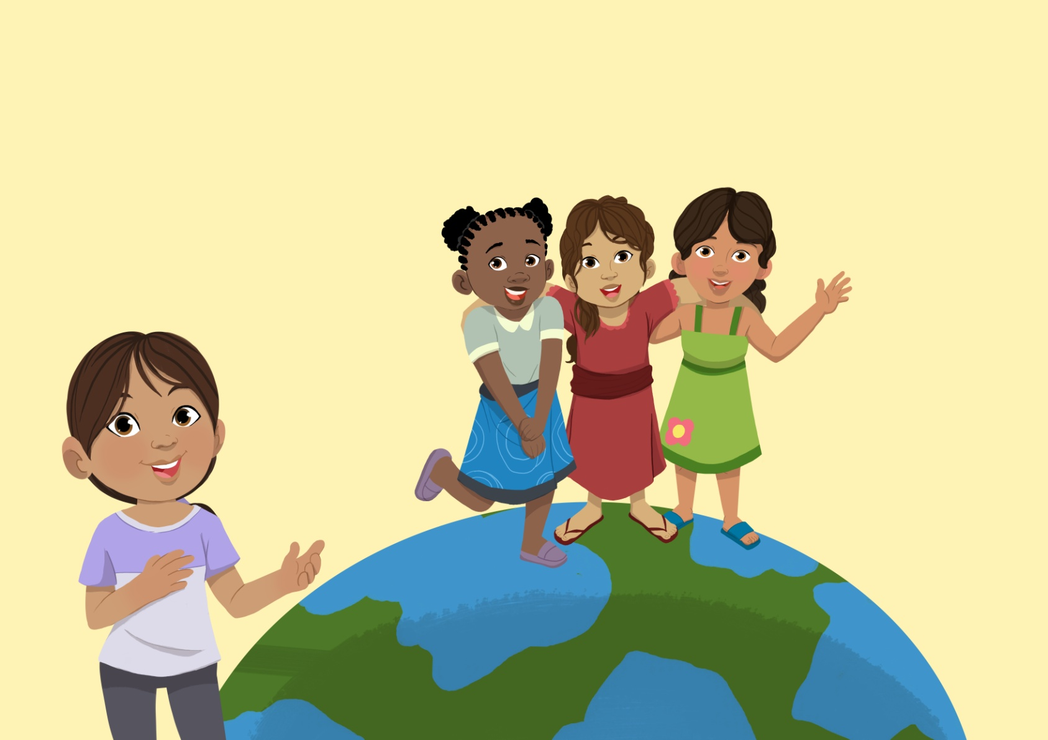
Frame 0

Slide 6
Frame 0
My name is Meena and I have 3 friends who live in three different parts of the world. I will introduce them to you as I go through the story.

Slide 7
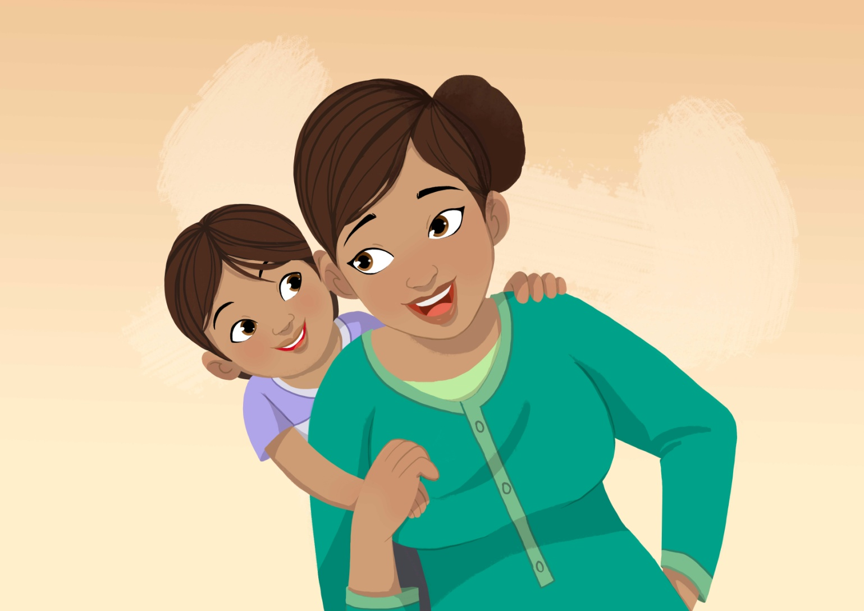
Frame 1

Slide 8
Frame 1
Intro: Magic Mum, Magic Hands
My mother and my friends’ mothers are ‘magic Mums’, and their hands are ‘magic hands’.
To you they may seem like any other mothers and their hands may seem like any other hands. But for us they are the most magical hands in the whole wide world.

Slide 9
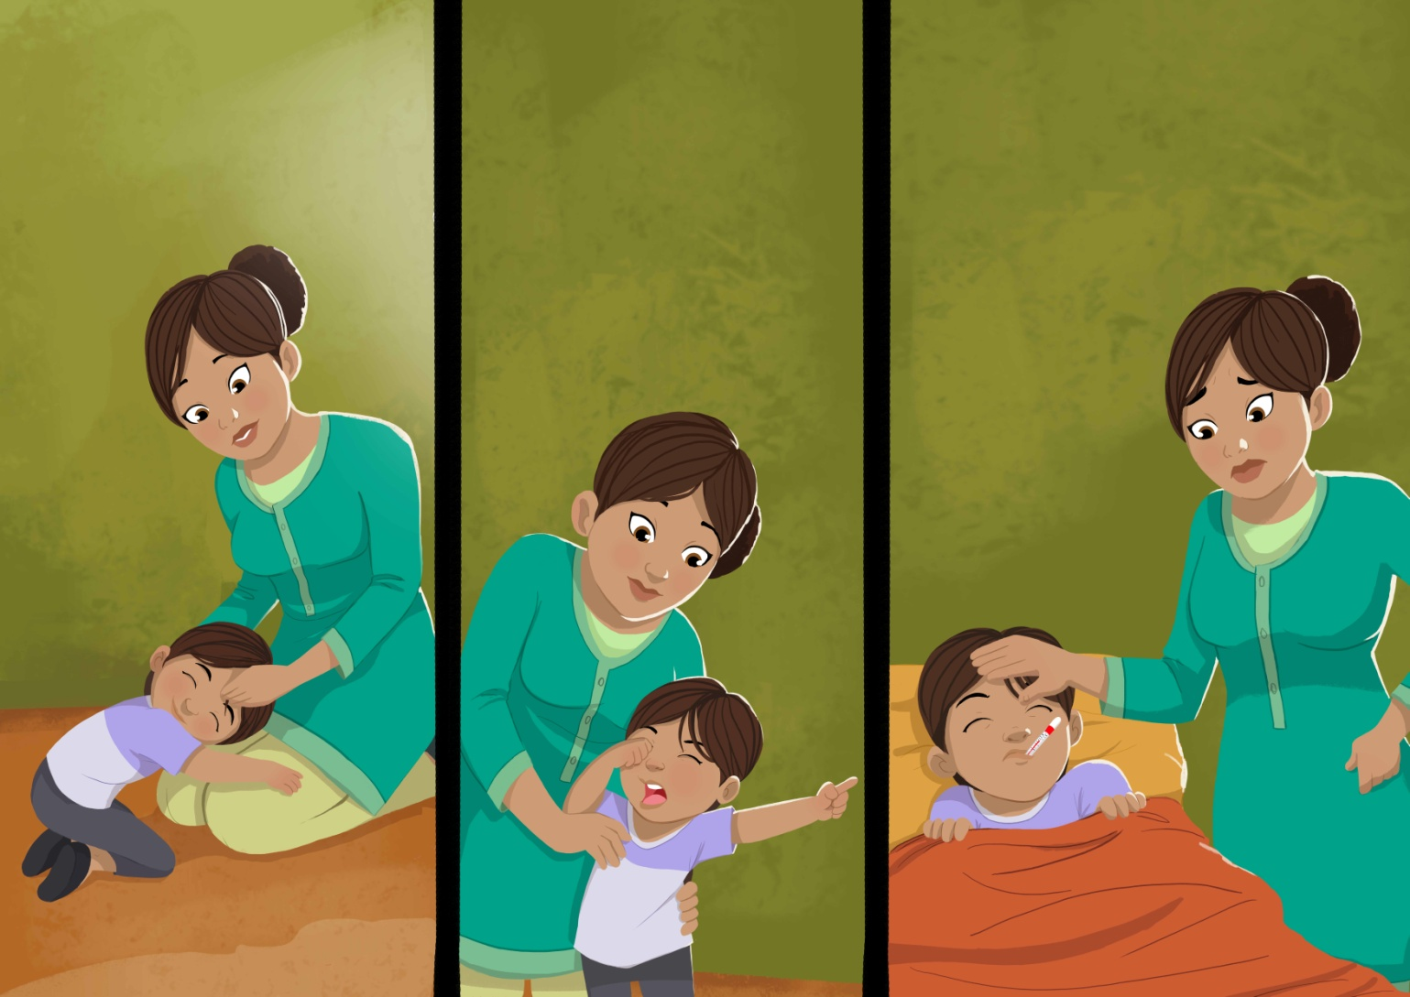
Frame 2

Slide 10
Frame 2
The magic of Mum’s hands
My Mum’s magic hands pat me to sleep when I am restless, they wipe my tears when I cry, and soothe me when I am sick…

Slide 11
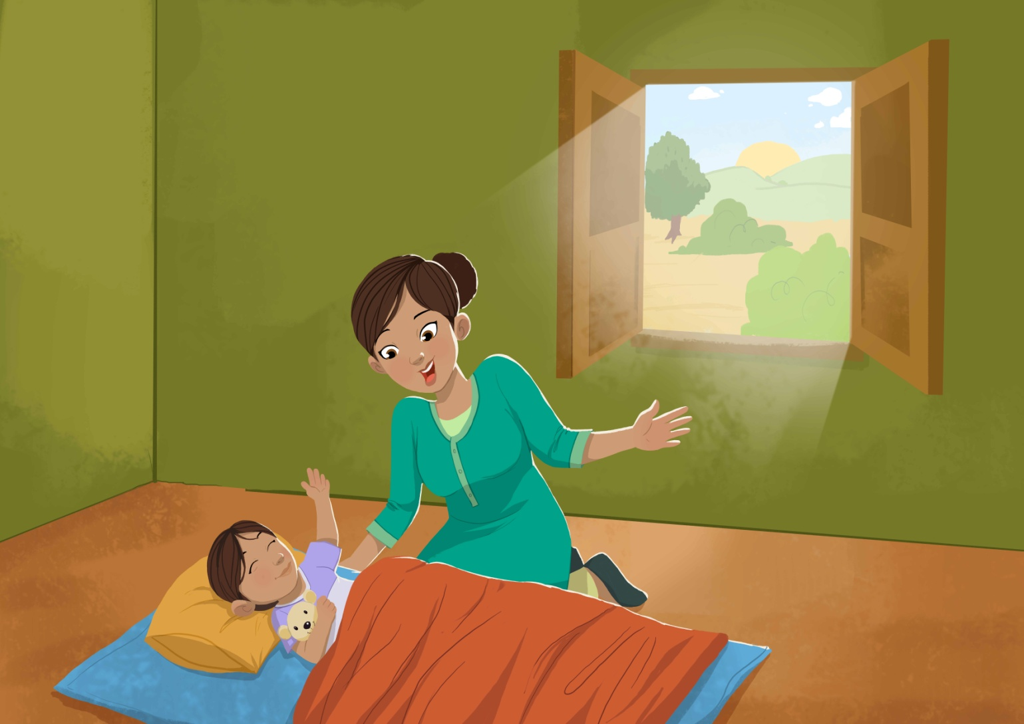
Frame 3

Slide 12
Frame 3
Waking
My day usually begins with her hands gently nudging me awake. On some days they run over my face and tummy and tickle me awake, those magic hands of my Mum.

Slide 13
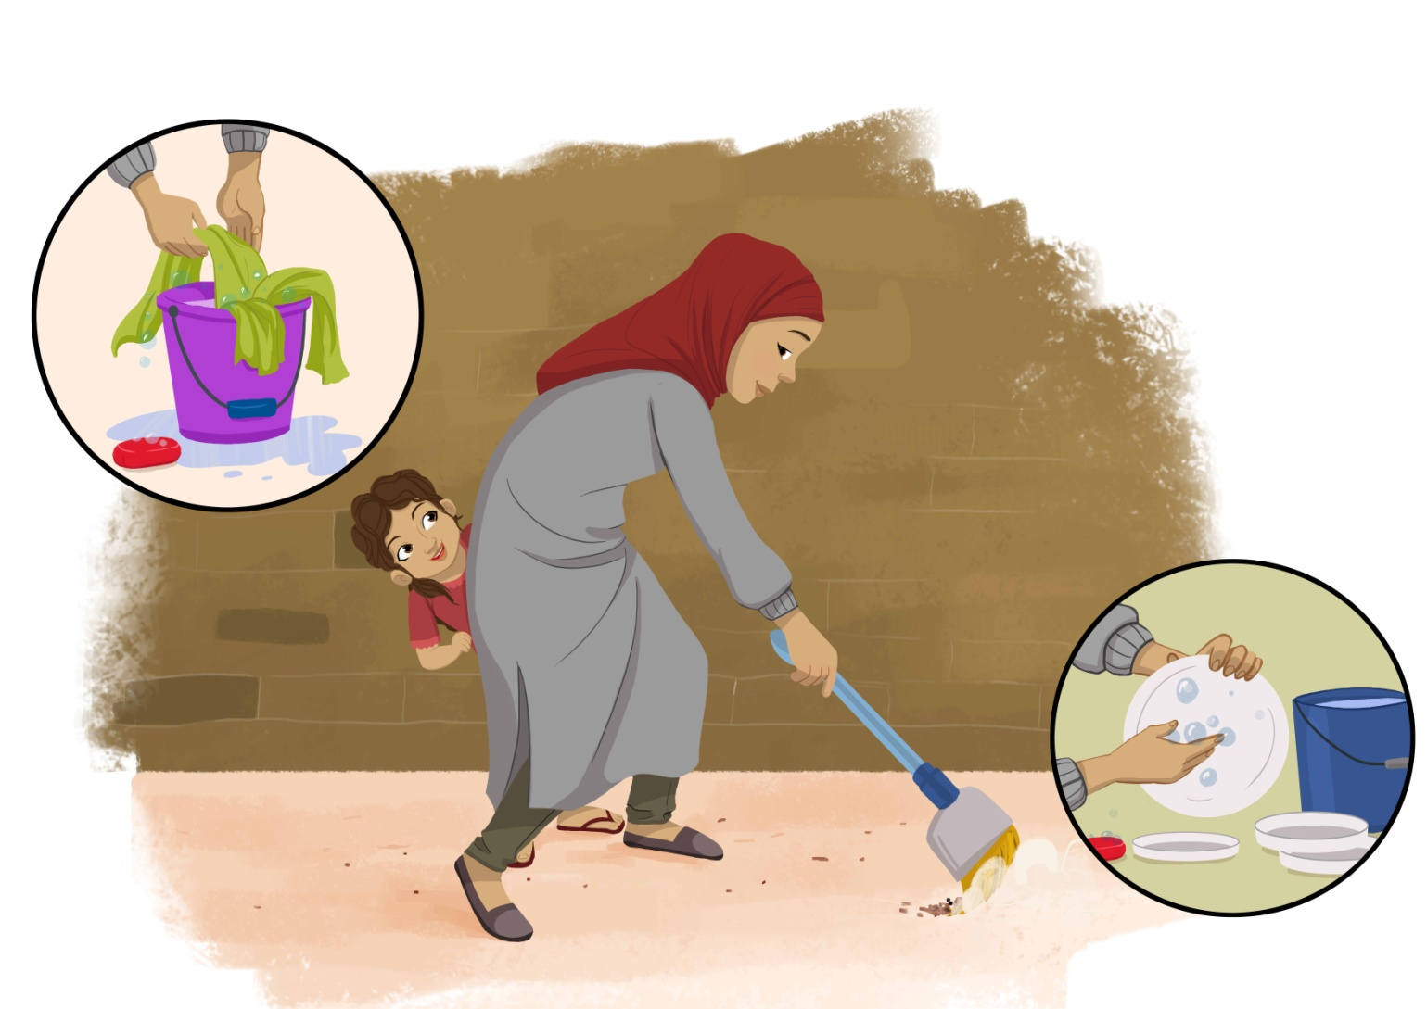
Frame 4

Slide 14
Frame 4
Magic hands
This is Miriam, my friend from the Middle East. When she opens her eyes, she sees that her Mum’s magic hands have already swept the ﬂoor. They wash and sweep and clean and cook almost eﬀortlessly. She could spend hours watching her magic hands move.

Slide 15
Frame 5

Slide 16
Frame 5
Toilet - germs – illness – absentia – failure
Like all of us, when Miriam wakes up she goes to the toilet. The moment she comes out of the toilet her Mum ensures that she washes her hands with soap. Miriam asks her Mum why, and she explains that there are invisible germs on her hands which don’t die when washed with plain water. This means she will fall sick and not be able to grow healthy and attend school once it re-opens.

Slide 17
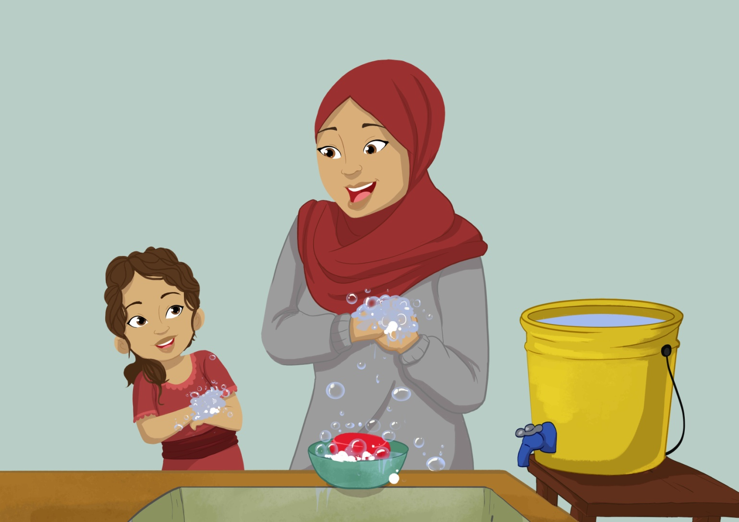
Frame 6

Slide 18
Frame 6
Mimicking ̶ soap ̶ good health ̶ success
Now that Miriam understands, she washes her hands carefully, imitating her Mum’s magic hands as they rub the soap all over themselves, every little crevice and tip. After that, their hands feel so fresh now that they are clean.

Slide 19
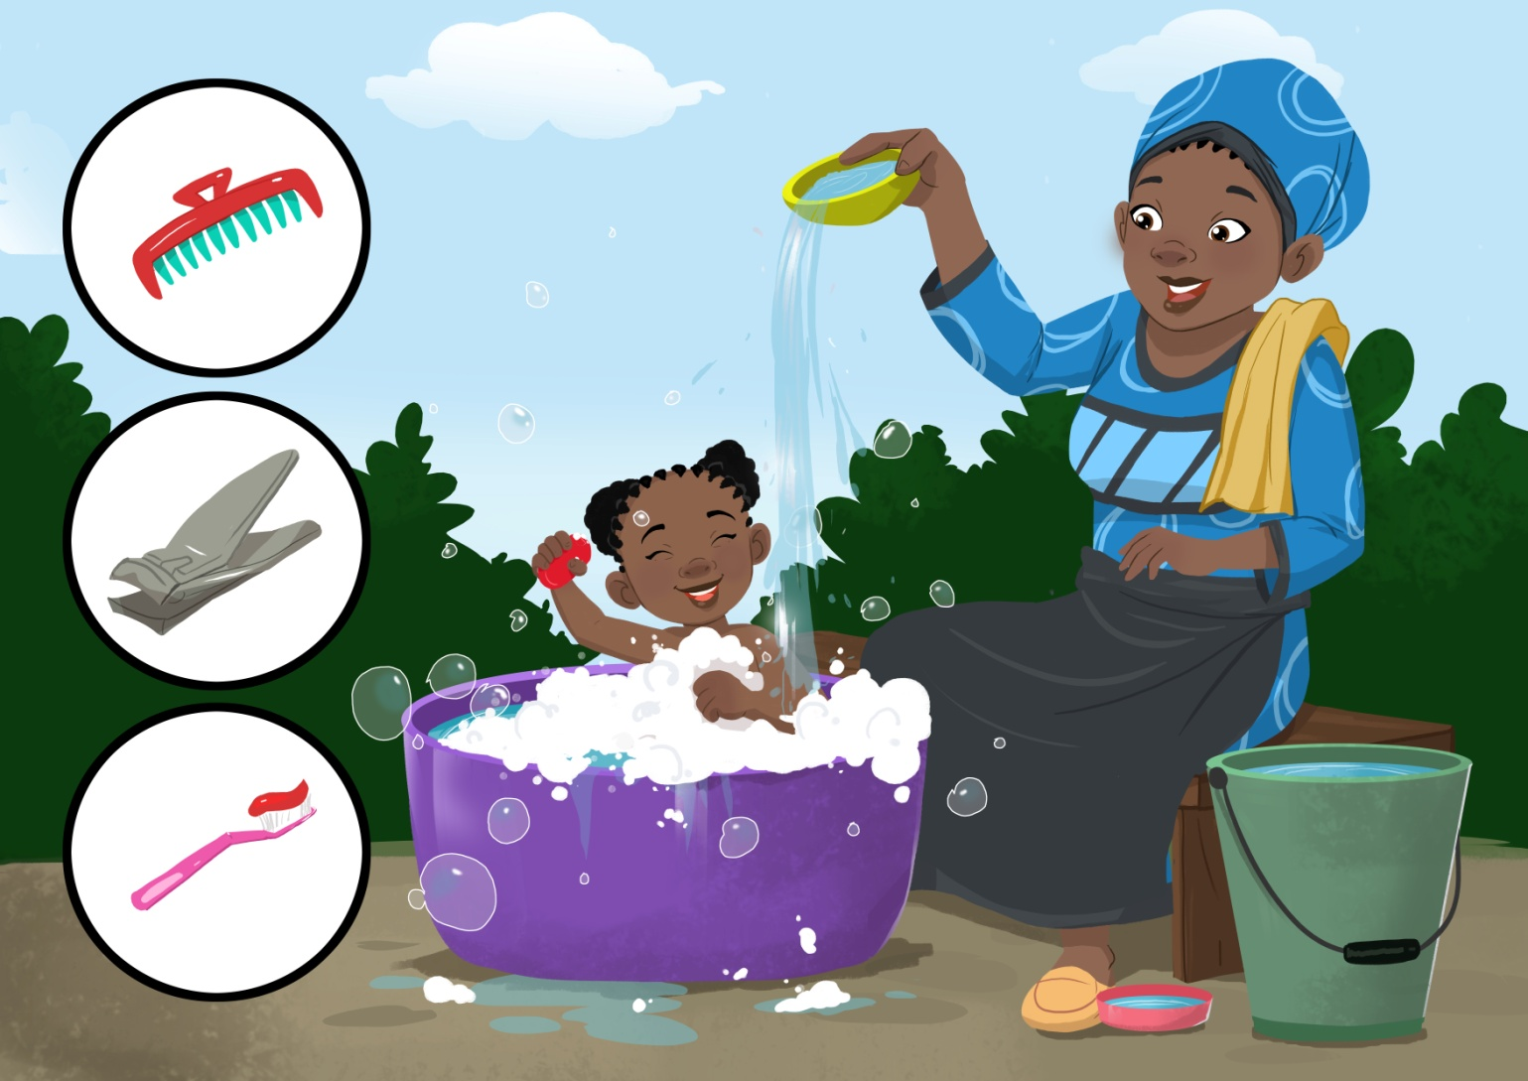
Frame 7

Slide 20
Frame 7
Hygiene manners
This is Mimi, another friend of mine. She is from Africa. Mimi’s Mum insists on bathing daily and marches her to the bathing area, her magic hands pouring water and scrubbing her with soap. Soon she feels fresh and clean.
“You must always brush your teeth, comb your hair, clean your body and cut your nails. How else will you grow up to be a successful, respectable woman?” Mimi’s Mum says, while giving a last stroke to her hair with her magic hands.

Slide 21
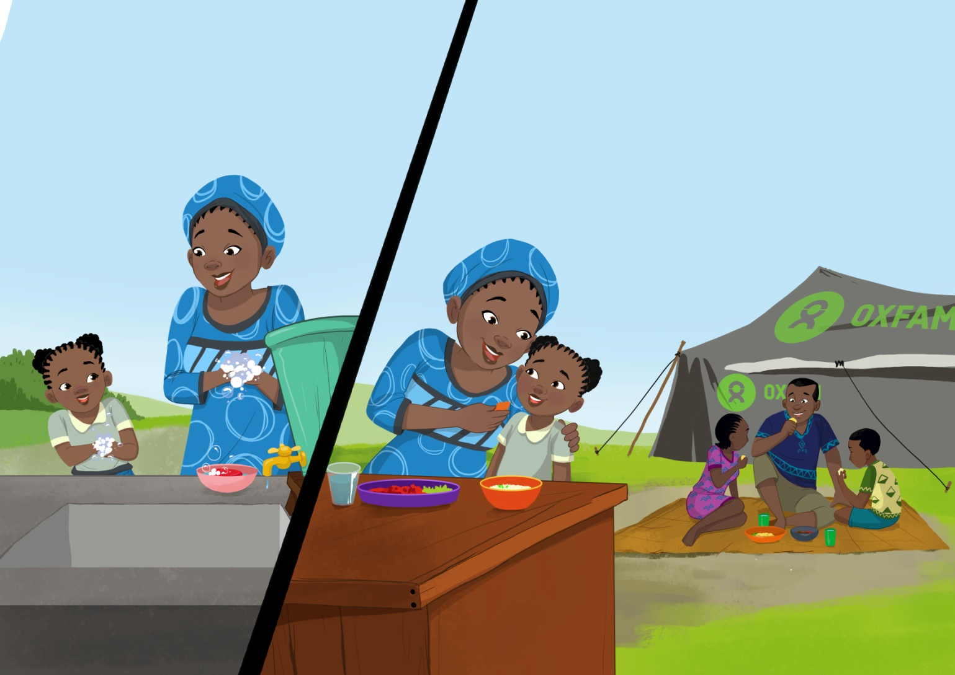
Frame 8

Slide 22
Frame 8
Eating + feeding + HWWS
Mimi sees her Mum preparing something to eat.
She is so hungry, she runs to her for food. If she forgets to wash her hands with soap, Mimi’s Mum reminds her: “If you want to grow healthy and strong, you must wash hands with soap”.
Mimi and her Mum wash their hands together again. Mimi starts eating by herself, but she soon persuades her Mum to feed her. Food tastes so much better from her magic hands.

Slide 23
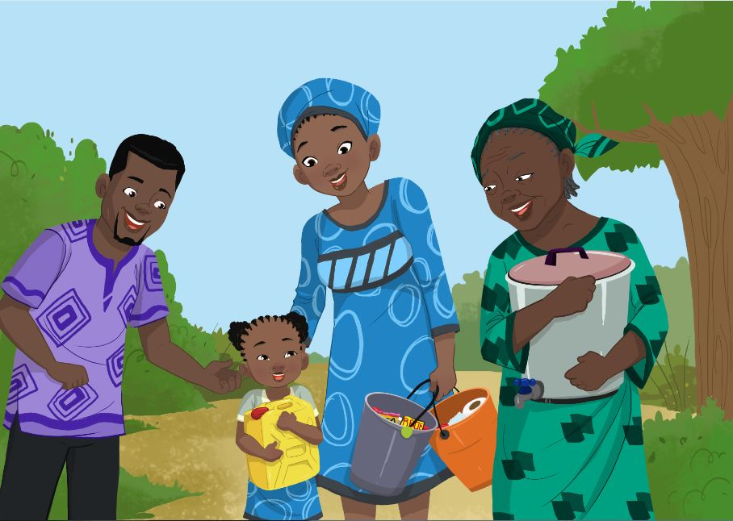
Frame 9

Slide 24
Frame 9
Behavioural manners
Mimi and her Mum walk back from a distribution. Her Mum is pleased as other mothers along the way admire Mimi’s clean clothes. “How lovely your little girl looks. How do you manage to take care of your family despite these diﬃcult circumstances and being so busy?” they ask Mimi’s Mum.
Mimi says: “Mum, see they appreciate I am clean”. Her mum replies: “Yes certainly daughter, not only because you are clean but also because you are hardworking, well mannered and respect elders. You make me proud!” Mimi’s Mum pats her on the head lovingly with her magic hands. Mimi closes her eyes and smiles.

Slide 25
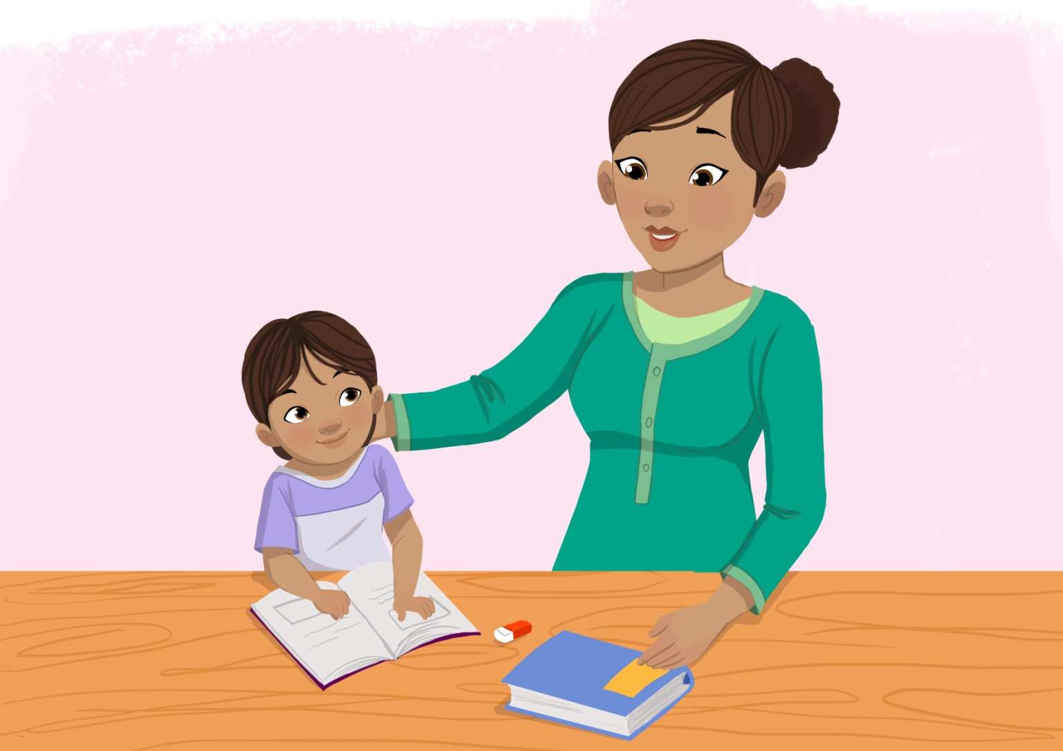
Frame 10

Slide 26
Frame 10
Homework + success
School’s not open yet, but I can’t wait to go back. While I wait for it to open, I like to practice the things I have already learned.
Mum sits next to me to listen while I practice my reading.

Slide 27
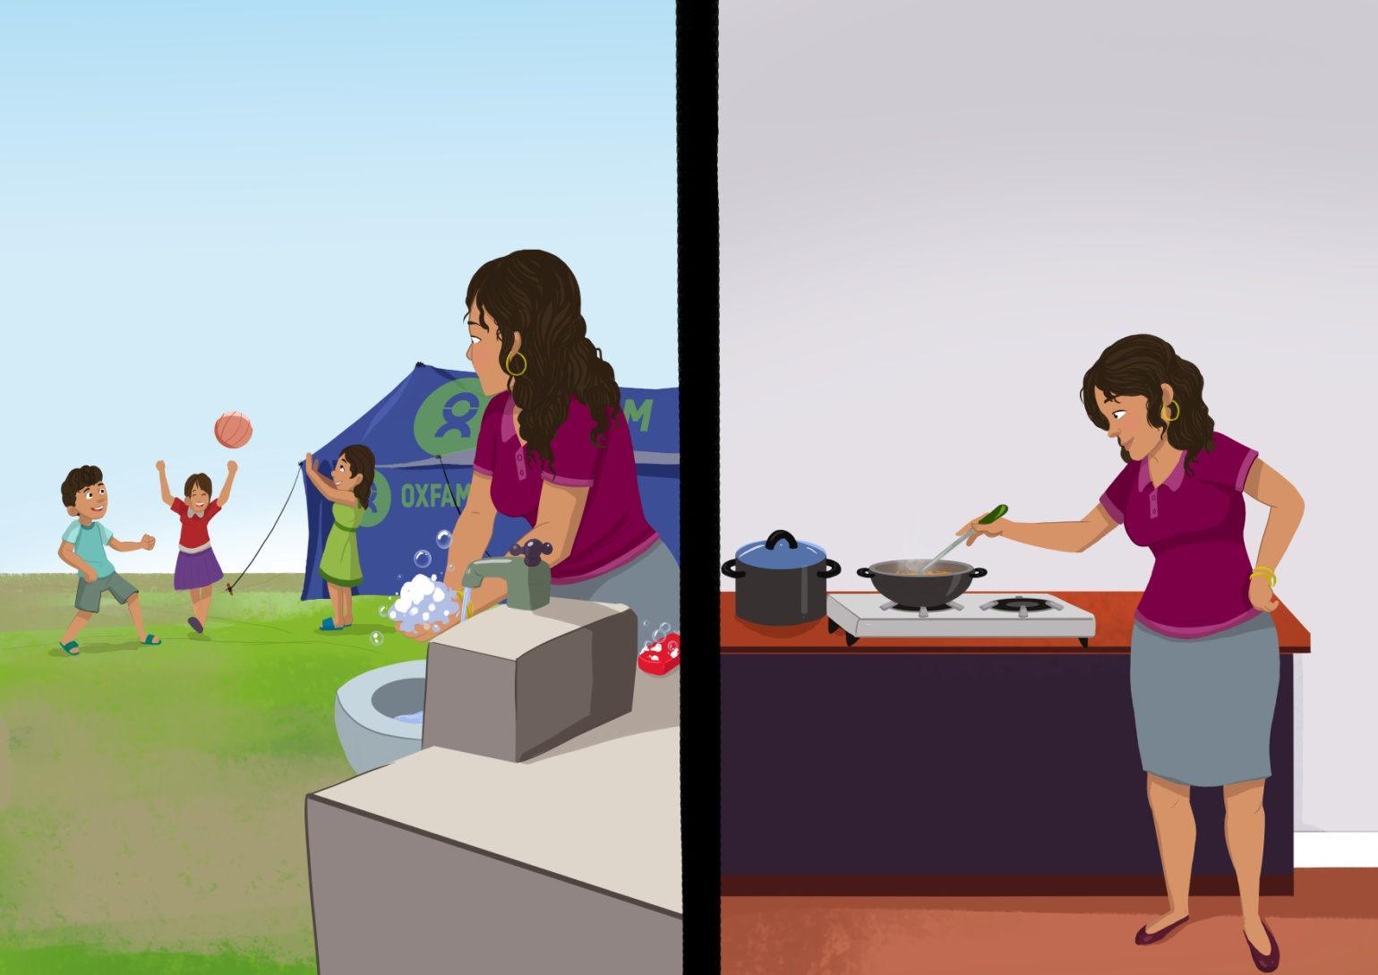
Frame 11

Slide 28
Frame 11
Cooking + HWWS
Here is my friend Maria, from Latin America. This is her most favourite part of the day – playtime. As she runs oﬀ, she sees her Mum washing her hands with soap before starting to cook. She never touches food without washing her hands, whether it is to prepare food, eat or feed Maria’s brothers and sisters.

Slide 29
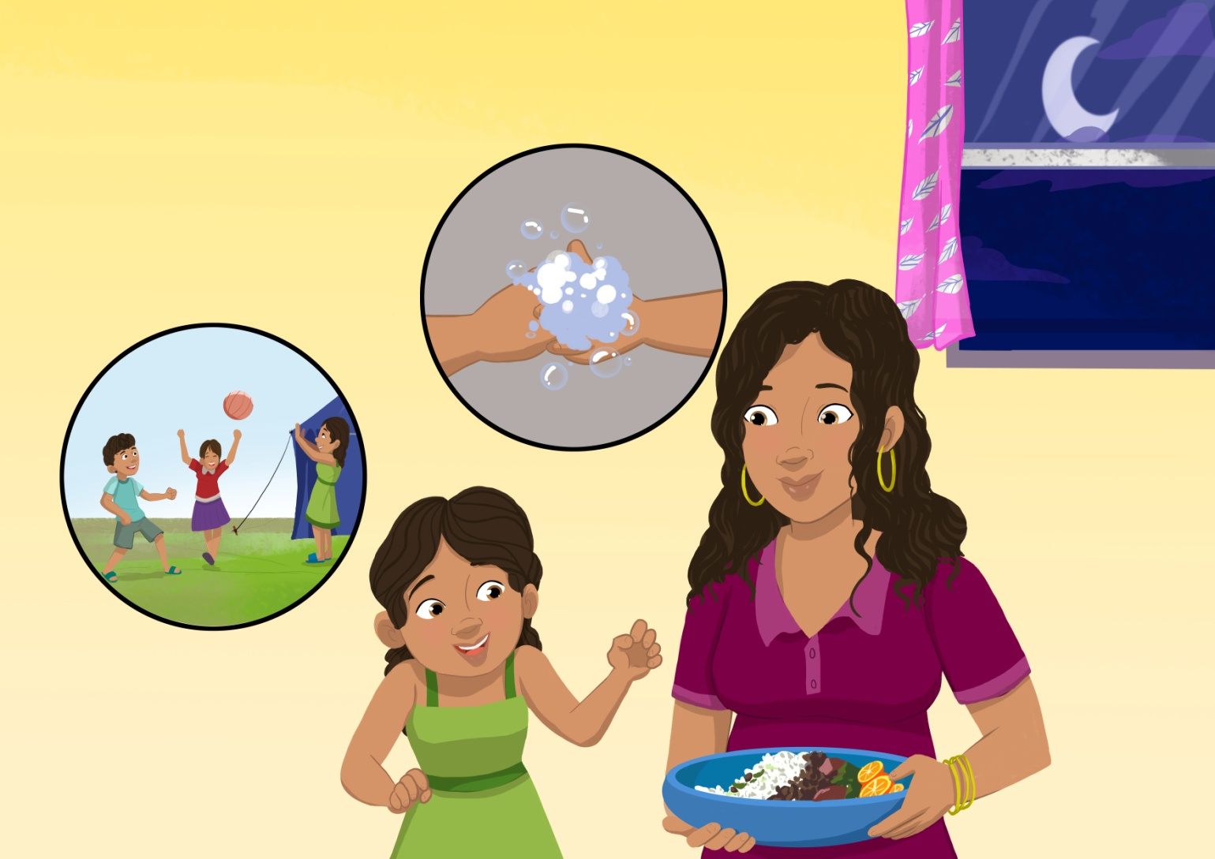
Frame 12

Slide 30
Frame 12
Dinner + HWWS
As Maria sits down to have her meal, she remembers to wash her hands with soap this time. She tells her Mum all about her day, about how she played with her friends and that she washed her hands with soap before coming to eat. Maria’s Mum is overjoyed and pats her on her back, remarking how good a girl she is.

Slide 31
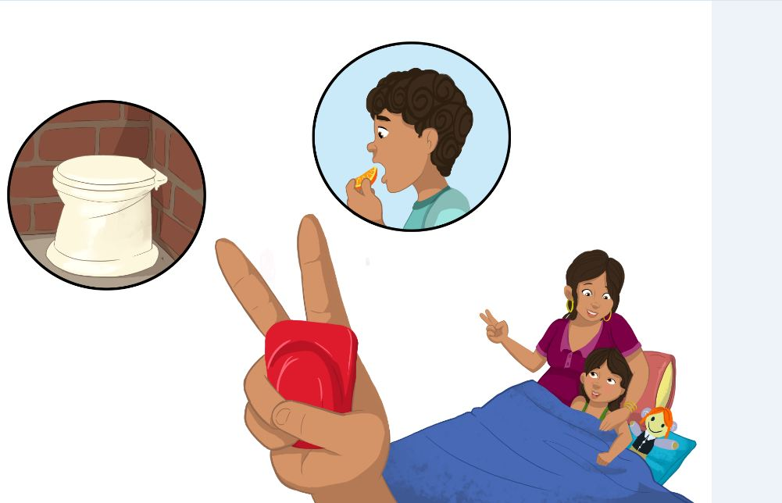
Frame 13

Slide 32
Frame 13
Sleep + success
After ﬁnishing her food and brushing her teeth, Maria lies down. She tells her Mum that at times she ﬁnds it hard to remember what she reads. Maria’s Mum says it’s just a matter of ﬁnding a smart way of reminding oneself.
For example, 2 ﬁngers for 2 occasions of handwashing with soap: before touching food and after going to the toilet. Two ﬁngers, 2 occasions, Maria repeats to herself. She smiles and falls asleep.

Slide 33
Narrator asks:
Do you want to know what happened to these girls?

Slide 34
Maria became a teacher,
Mimi became a lawyer, and
Miriam became an engineer.
As for Meena, she became a doctor...
listen to what she says:

Slide 35
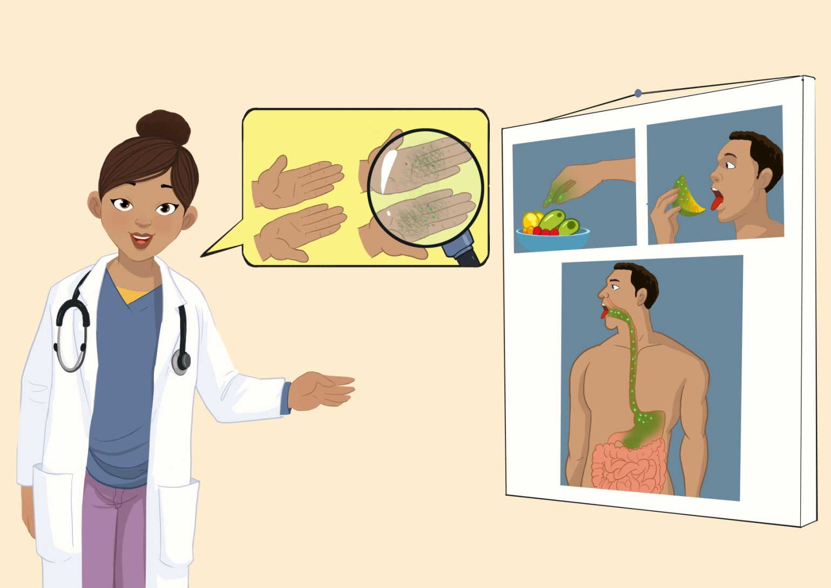
Frame 14

Slide 36
Frame 14
Doctor: the germs story
Today I am a doctor!
Apart from those in the story, many of my other friends would fall ill when we were younger. Our surroundings made it difficult. But not for me, because of my Mum’s insistence on washing hands with soap.
When we wash with just plain water, our hands look clean, but there are invisible germs which pass on from our hands and infect our children.

Slide 37
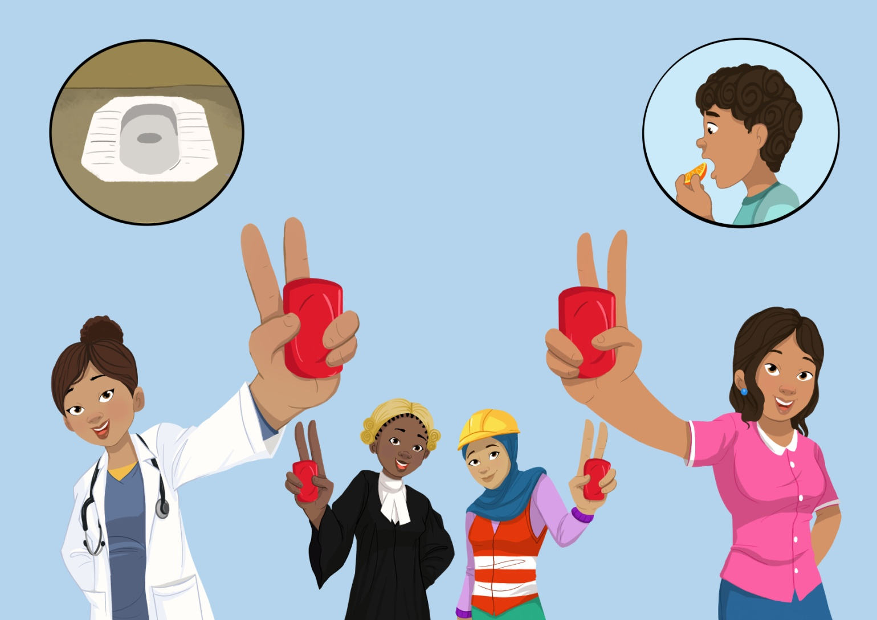
Frame 15

Slide 38
Frame 15
Recap occasions
Now after all these years, my life is testimony to my Mum and her magic hands. So pay careful attention to these little things. As my Mum did, ensure that you instill good manners in your children and also the habit of handwashing with soap before eating and after going to the toilet.
And don’t forget the other important times for Mums: before preparing food, before feeding your child and after cleaning your child’s faeces. After all, it’s your magic hands that shape the destiny of your child.

Slide 39
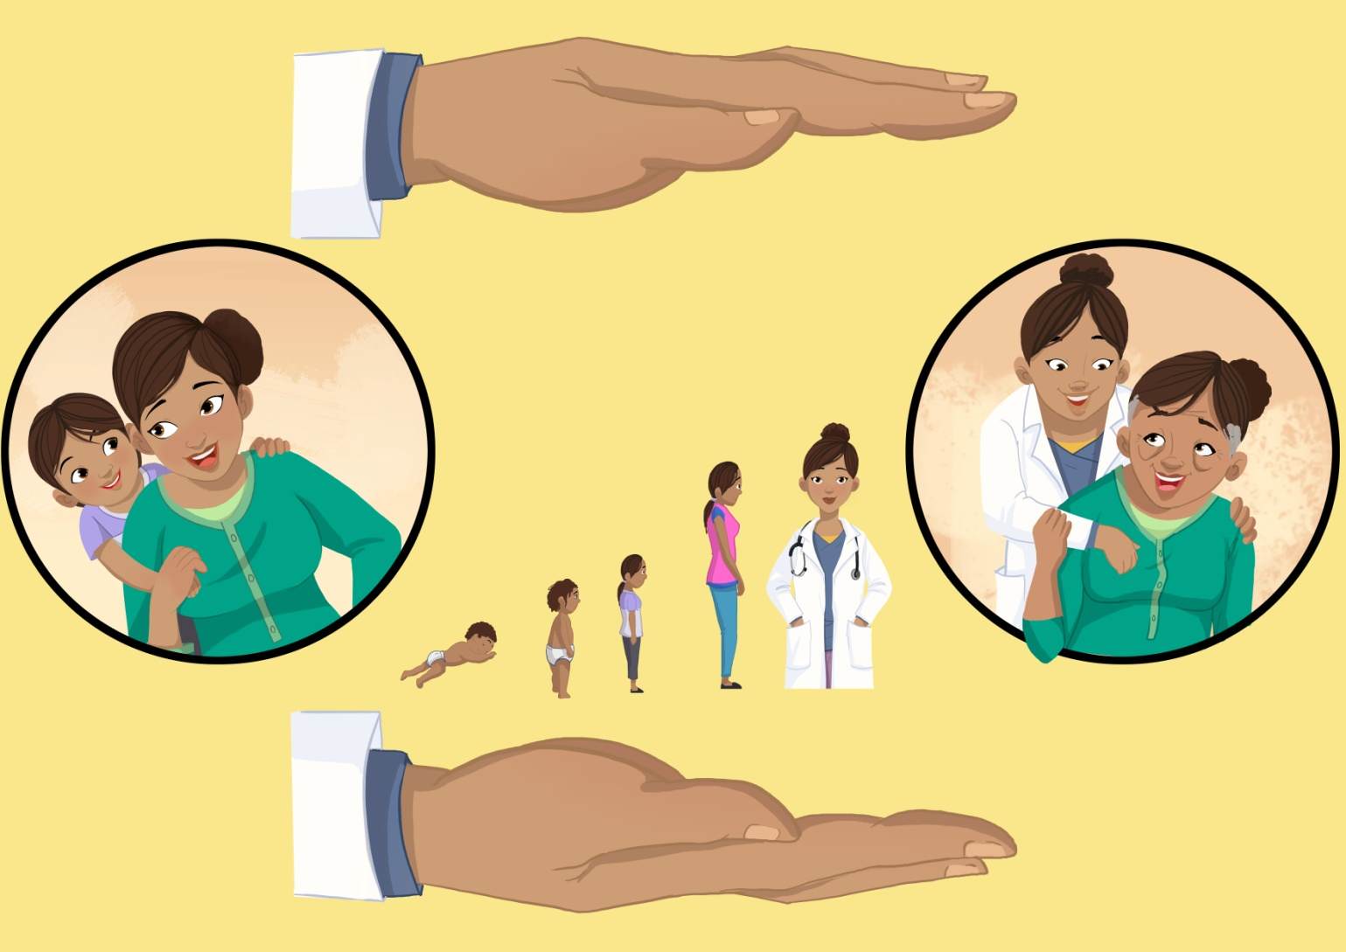
Frame 16

Slide 40
Frame 16
Final sign off Mum
Now, each time people congratulate me on how well I have done, I always tell them that I would not be where I am today had it not been for my Mum’s magic hands, which cared and looked after me during the tough and busy times.
From the time I was a baby, as I grew up to become a child, and now ﬁnally a doctor, her magic hands nurtured and cared for me. My Mum’s magic hands mean the world to me.

Slide 41
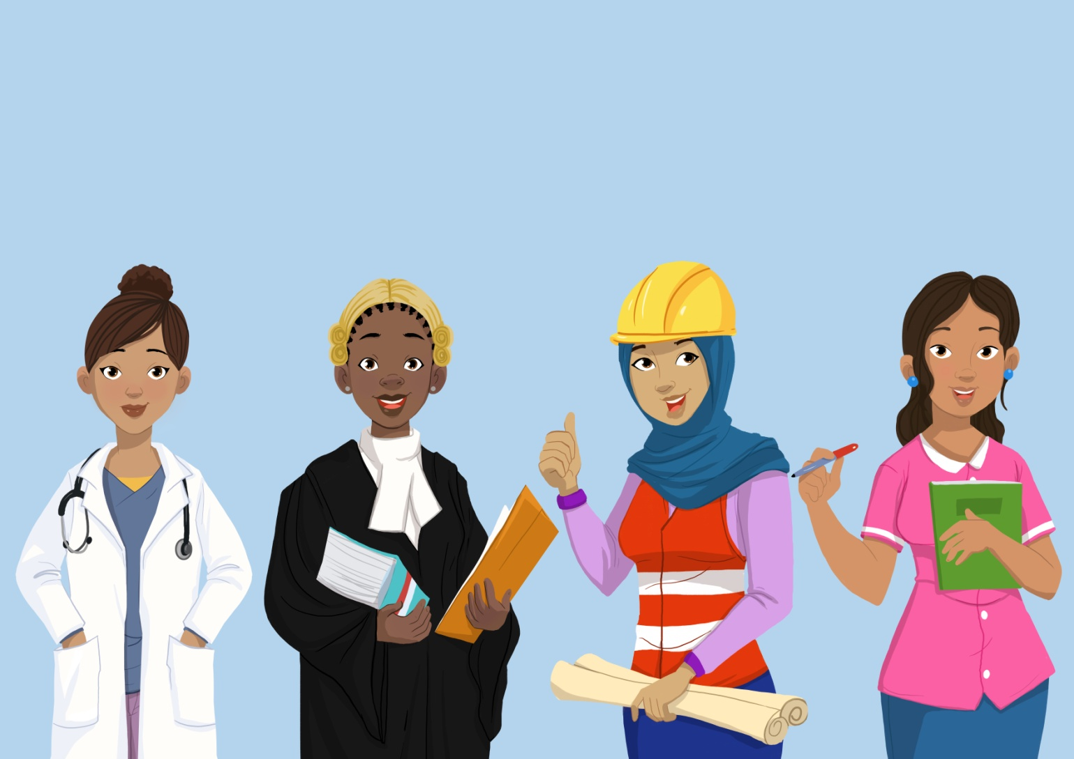
Frame 17

Slide 42
Frame 17
Finale
And look how well Miriam, Mimi and Maria have done!
They too would not be where they are today had it not been for their Mums’ magic hands! Our Mums’ magic hands mean the world to us!

Slide 43
Thank you
Illustrations: Segun Samson
With thanks to Minds Eye Creative, South Africa and to Centre of Gravity for inputs to design concept

