Slide 1

HAND HYGIENE
WASH FIT

Slide 2
Objectives
The importance of hand hygiene
Appropriate hand hygiene methods
Correct hand hygiene technique
The different uses of water and soap vs. alcohol based hand rub

Slide 3
Hand Hygiene
Is the best way to prevent the spread of germs in the healthcare setting and community
Protects staff, patients and visitors from a range of health care acquired infections
Can be used in health care settings to demonstrate to the community good hygiene behaviour

Slide 4

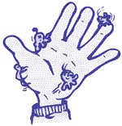
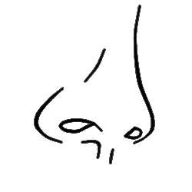

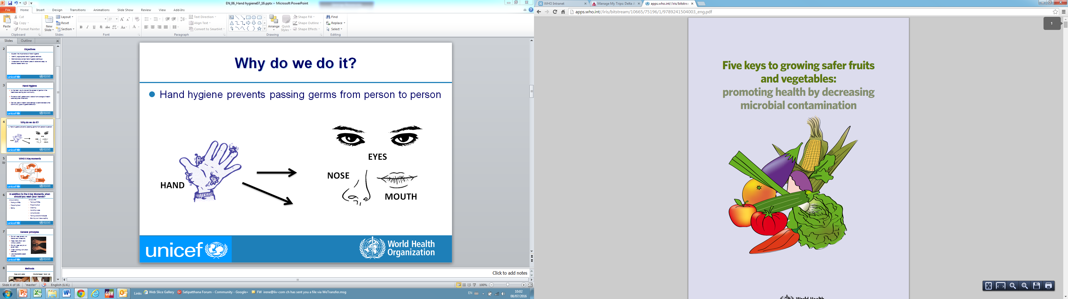
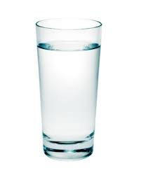
Why do we do it?
Hand hygiene prevents passing germs from person to person or from person to food or water
EYES
HAND
NOSE
MOUTH
FOOD
WATER

Slide 5
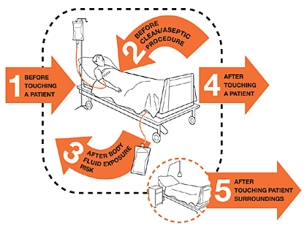
WHO 5 Key moments

Slide 6
In addition to the 5 Key Moments, when should you wash your hands?
Always before:
Putting on personal protective equipment
Preparing food
Eating
Always after
Taking off personal protective equipment
Cleaning
Handling waste
Using the toilet or changing a child's diaper
Taking care of animals/pets
Blowing your nose, coughing

Slide 7
General principles
Do not wear jewelry on hands and forearms;
Keep nails short and without polish;
Do not wear acrylic or glued nails;
Wear clothing with short sleeves;
Use disposable paper towels for drying

Slide 8
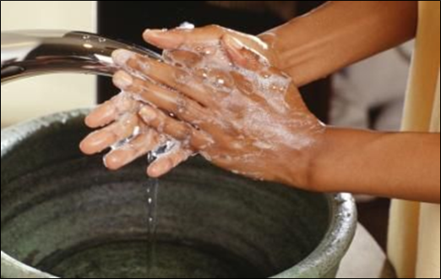
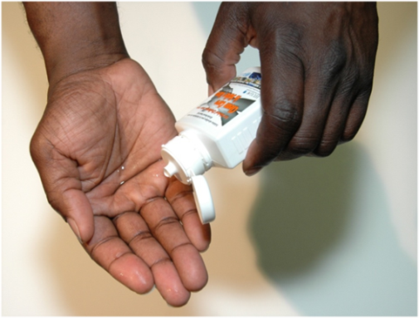
Methods
Soap and water
Alcohol-based hand rub

Slide 9
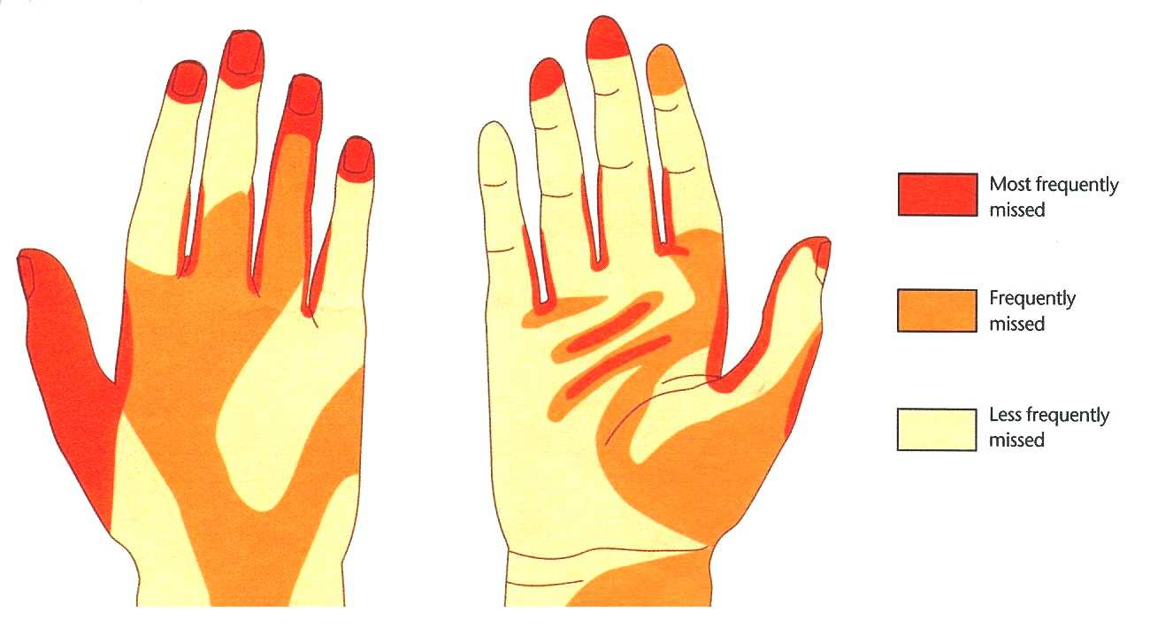
Commons areas that are missed
Most frequently missed
Frequently missed
Least frequently missed
Back of hand
Front of hand

Slide 10
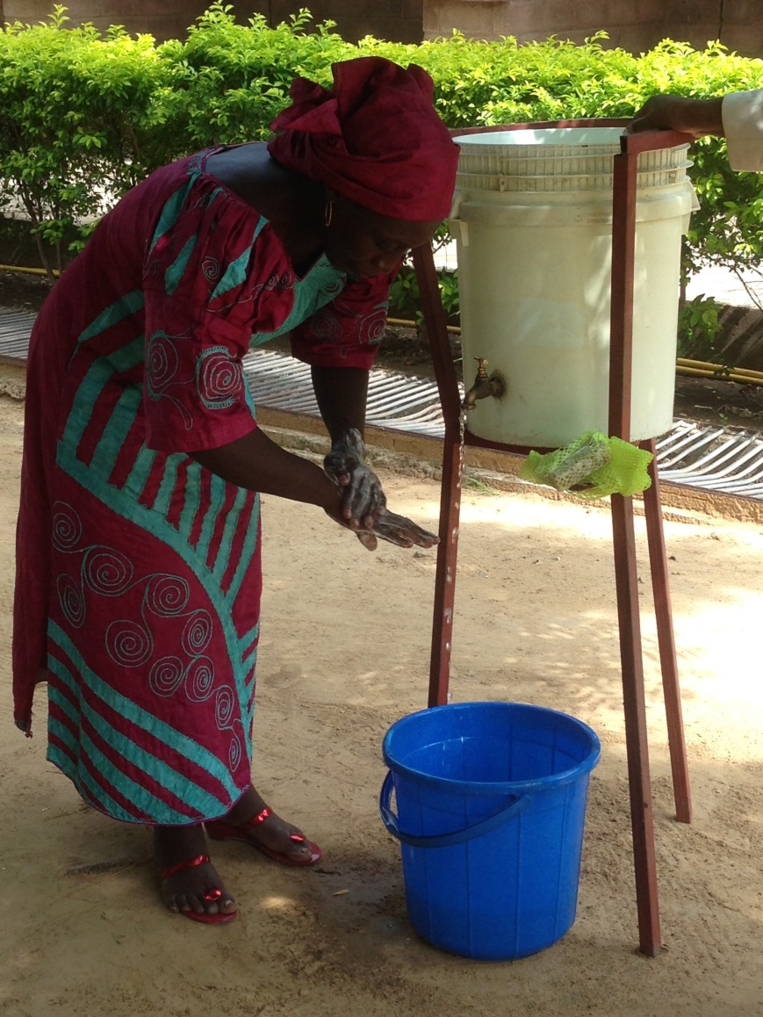
Soap and Water
Hand hygiene stations should have:
Clean water
Liquid OR bar soap
Disposable paper towels
Drainage for the water
  If using bar soap, be sure its stored correctly for water to drain

Slide 11
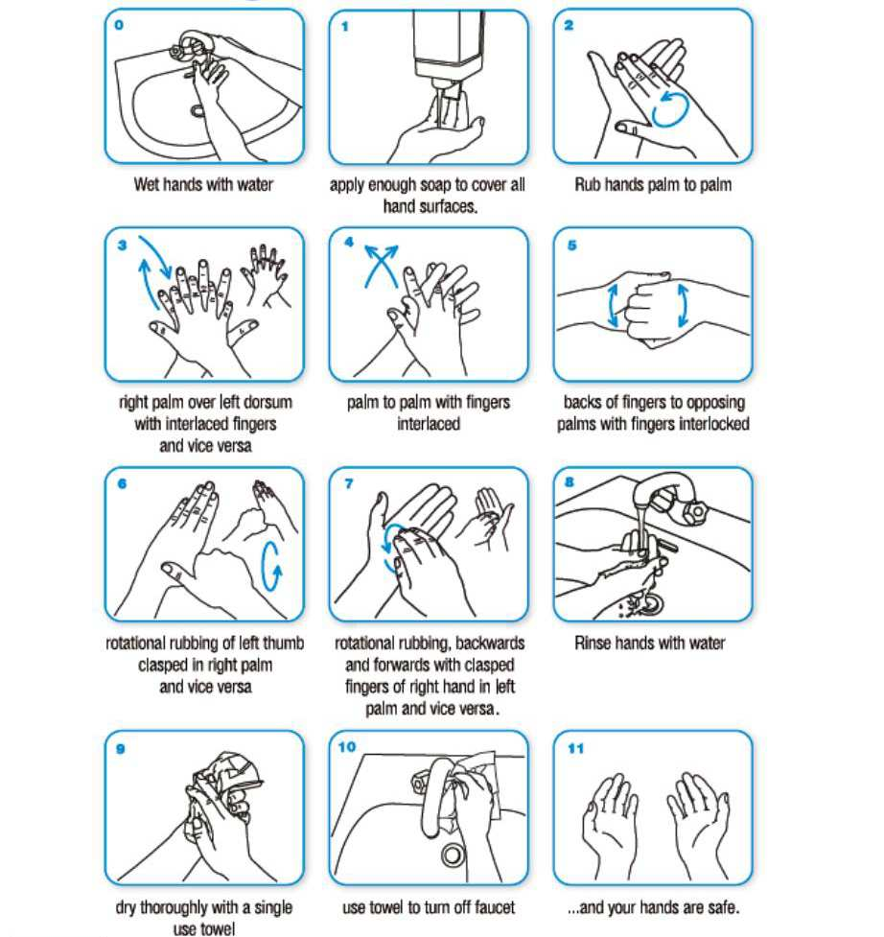
Technique - Soap and Water
Be sure to rub both wrists
Wash hands for 40–60 seconds!

Slide 12
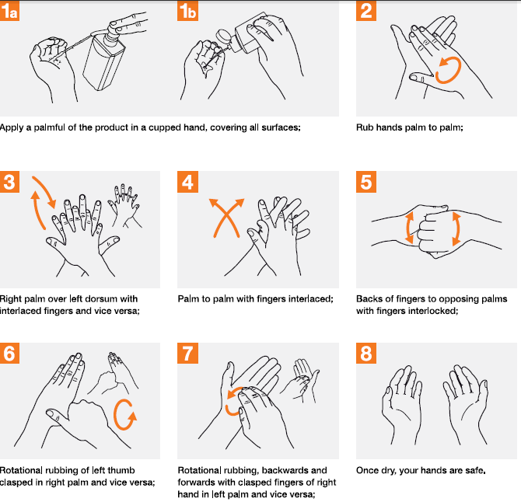
Technique – Alcohol based hand rub
Be sure to rub both wrists
Rub for 20–30 seconds!

Slide 13
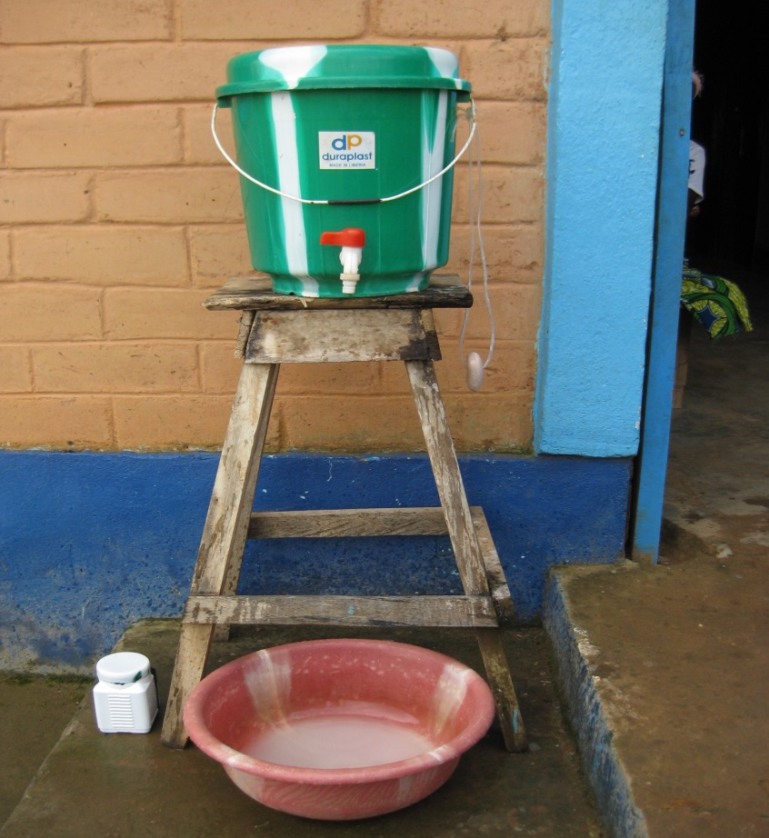
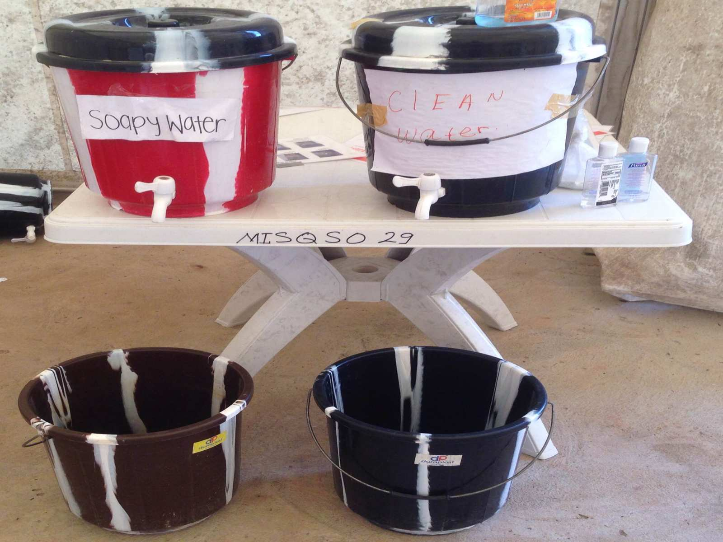
Placement of Hand Hygiene Stations
Stations should be placed at all points of entry, points of care AND within 5m of toilets.

Slide 14
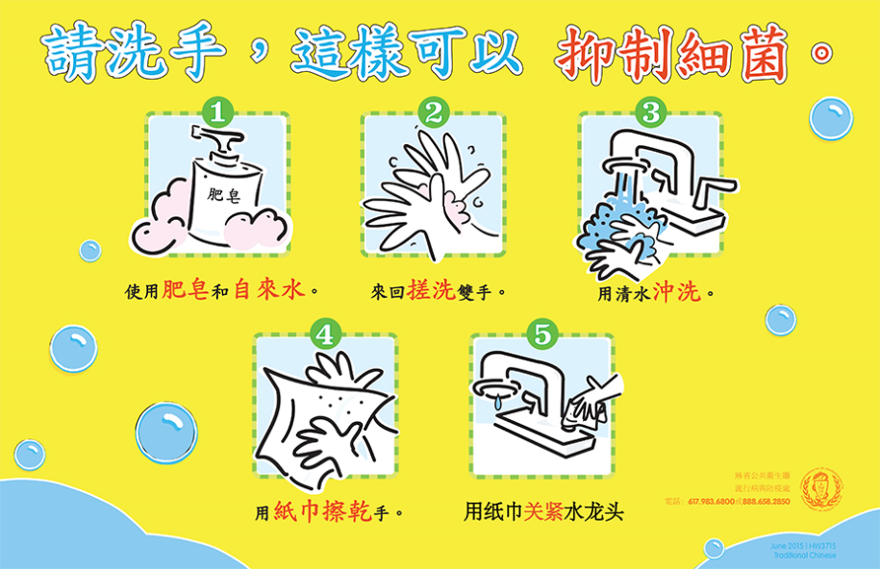

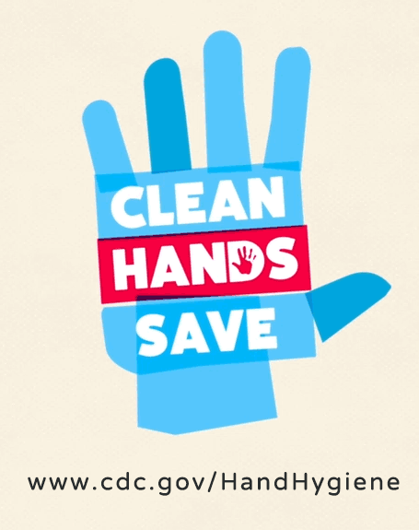

Hygiene promotion
Promotion materials should be clearly visible at key places and understandable

Slide 15
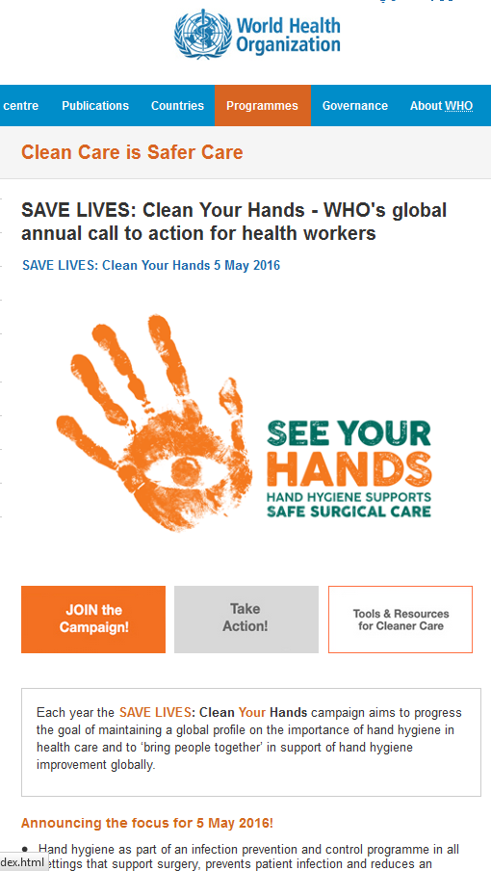
Global Hand Hygiene Day
Each year the SAVE LIVES: Clean Your Hands campaign aims to progress the goal of maintaining a global profile on the importance of hand hygiene in health care and to ‘bring people together’ in support of hand hygiene improvement globally.
Campaign resources available:
http://www.who.int/gpsc/5may/en/

Slide 16
Hand hygiene indicators
ESSENTIAL
Functioning hand hygiene stations are available at all points of care.
Hand hygiene promotion materials clearly visible and understandable at key places.
ADVANCED
Functioning hand hygiene stations are available in service areas.
Functioning hand hygiene stations available in waste disposal area.
Hand hygiene compliance activities are undertaken regularly.

Slide 17
Questions?

